Slide 1
Improving Implementation Research Methods for Behavioral and Social Science Working Meeting
Measuring Enactment of Innovations and the Factors that Affect Implementation and Sustainability:
Moving toward Common Language and Shared Conceptual Understanding
Jeanne Century
Center for Elementary Mathematics and Science Education
University of Chicago
September 20th, 2010

Slide 2
Key Questions
How and why do innovations spread and last?
What is the innovation? What is spreading and lasting?
Two National Science Foundation supported projects:
Accumulating Knowledge on Scaling and Sustaining Reform: A Foundation for Future Research
Applying Research on Science Materials Implementation: Bringing Measurement of Fidelity of Implementation to Scale

Slide 3
Why Ask? We need to….
Determine if innovations are effective
Determine which parts of innovations are effective
Determine why and under what conditions parts of innovations are effective
Determine how to support the spread of effective innovations with continued effectiveness
Determine how to support the endurance of innovations

Slide 4
Key Challenges
Use of multiple terms to mean the same thing
Poor or absent definitions
No conceptual frameworks
Multiple conceptual frameworks
Innovations don’t replicate; they translate

Slide 5
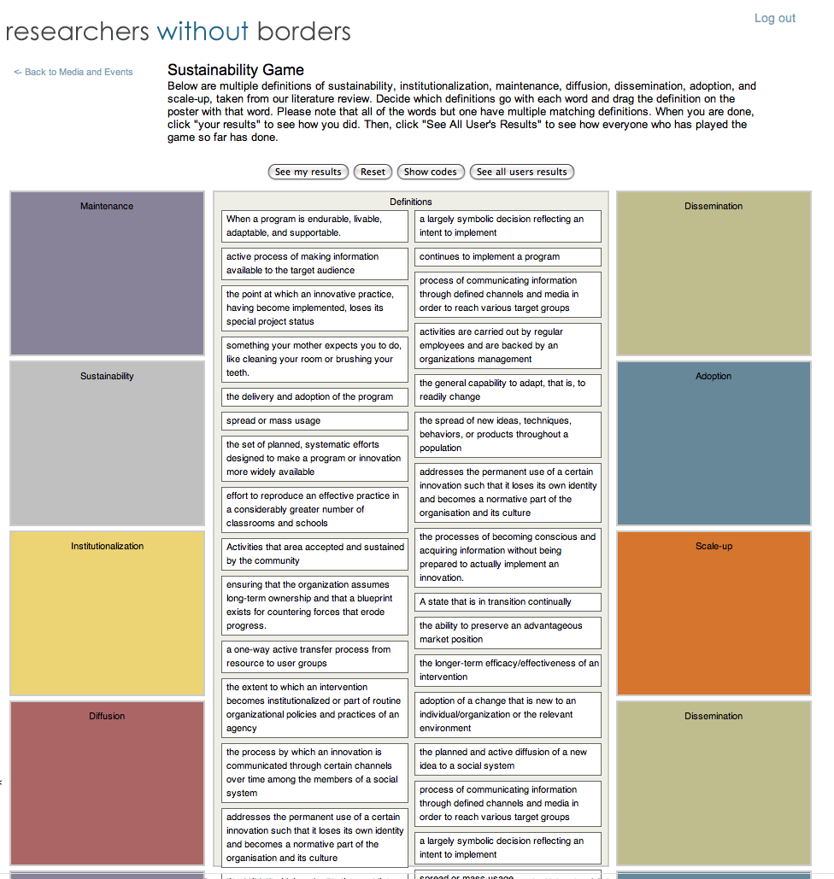
The Need for Common Language

Slide 6
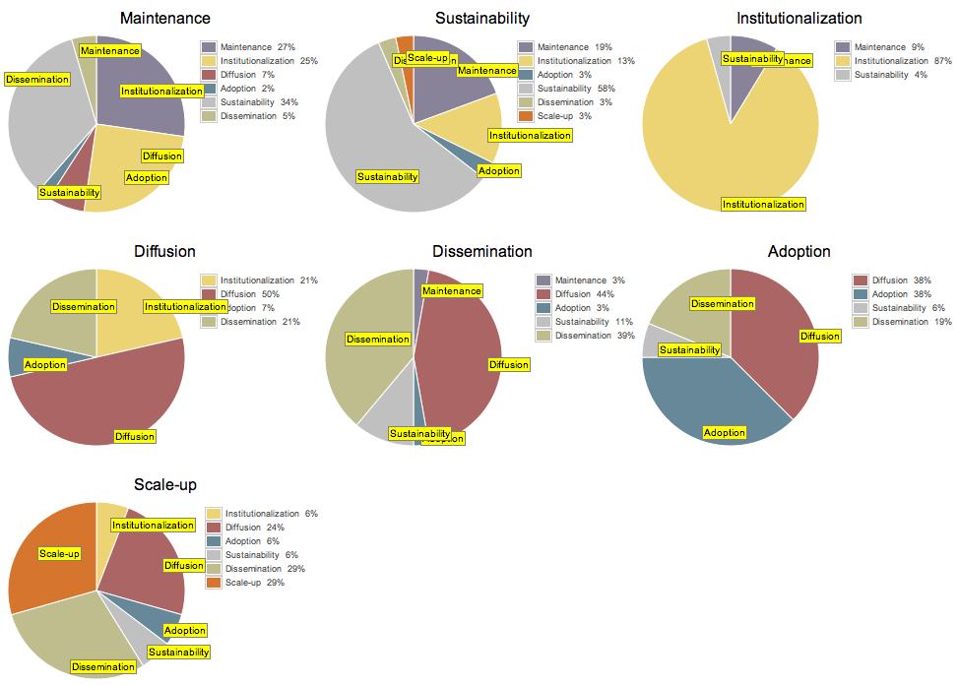
The Need for Common Language

Slide 7
Outcomes of NSF Supported Projects
A conceptual framework that provides a foundation for instruments for measuring enactment of multiple innovations
A suite of instruments to measure enactment of innovations that can be used alone or in combination depending on resources and goals
Instruments that provide clear and specific information about enactment of the innovation
Identification of factors affecting implementation (and sustainability)
Clear, literature-based definitions of the factors affecting implementation (and sustainability)
Conceptual organization of the factors that creates a starting point for measuring and modeling strength and direction of relationships

Slide 8
Definitions for Fidelity of Implementation (FOI)
FOI
The extent to which an enacted program is consistent with the intended program model
Critical Components
The elements of a program model that are essential to its implementation
FOI Operationalized
The extent to which the critical components of a program are present when the program is enacted

Slide 9
FOI Approaches
Five Dimensions Approach Dane and Schneider (1998) 39/162 studies measured integrity • In the 39 studies, the authors defined “integrity” along one or more of five dimensions • the dimensions are: 1) adherence; 2) exposure; 3) quality of delivery; 4) participant responsiveness and 5) program differentiation
Structure and Process Approach Mowbray et al. (1987), Wang et al. (1984) Structure (composition of the intervention)
Process (human interactions that take place during delivery)
Combining Frameworks Approach
Ruiz Primo (2005) – matrix of 5 dimensions and structure/process
Lynch and O’Donnell (2005); Lastica and O’Donnell (2007) – matrix of 5 dimensions and structure/process
Critical Components Approach Hall and Hord (1987), Bond et al. 2000; Huntley, 2005; Sabelli & Dede (2001) and others Some called them model dimensions, fidelity criteria, critical parts

Slide 10
FOI Approaches
CEMSE Approach
Combine critical component approach and structure process approach
Show relationships to 5 dimensions approach
Use combination of approaches to create categories of critical components and a framework that can apply to multiple interventions

Slide 11
FOI Framework
FOI of Instructional Materials
Categories of Critical Components
Structural |  | Instructional
Procedural | Educative | Pedagogical | Student Engagement

Slide 12
CEMSE Framework Aligned with Other Approaches
Categories of Differentiation (differentiation)
Common Across Interventions
Unique to Interventions
FOI of Instructional Materials (adherence)
Categories of Critical Components
Structural (structure) |  | Instructional (process)
Procedural (exposure; dosage) | Educative | Pedagogical (quality) | Student Engagement (participant responsiveness)

Slide 13
Categories of Differentiation
Categories of Differentiation
Common
Program A
Program B
Program C
FOI of Instructional Materials
Categories of Critical Components
Structural |  | Instructional
Procedural | Educative | Pedagogical | Student Engagement
Impact of a single program
Compare two or more programs
Compare programs to “business as usual”
Compare two versions of a program

Slide 14
Project on Factors Affecting Implementation and Sustainability
Looked at economics, business, health, marketing, education
Reviewed over 69,000 abstracts
Read and coded over 600 reports
Reconciled definitions used in the literature and conceptually organized them

Slide 15
Factors Affecting Implementation and Sustainability
Implementation: Enactment of an innovation at a given point in time
FOI: The extent to which an enacted program is consistent with the intended program model
Sustainability: Lasting of an innovation characterized by its evolution and adaptation
Maintenance: Lasting of an innovation characterized by a lack of change

Slide 16
Factors Affecting Implementation and Sustainability
Ways of Lasting
Sustainability
Maintenance
Movement
Elements of the Environment (Outside)
External Climate: Social
External Climate: Political
Networks
Resource Allocation
Types of Movement
Diffusion
Dissemination
Adoption
What Lasts
The Innovation
Ongoing Effectiveness
Asking users for input, but not engagement them in decisions related to an innovation
Locus of Movement
Movement: Originator to User
Movement: User to User
Properties of the Innovation
Visibility
Scope
Complexity
Adaptability
Specificity
Effectiveness
Elements of the Environment (Inside)
Internal Organizational Structure
Internal Social Climate
Resource Allocation
Strategies
Planning
Mandate
Formative Evaluation
Feedback
Collaborative Change Process
Elements of the Environment
Incentives
Opportunities for Learning
Locus of Decision-Making
Characteristics of People in the Organization
Sophistication of the User
Quality of Leaders
Characteristics of the Implementer
Reasons for Decisions
Buy-In
Compliance
Reward
Fit
Fit: Current Practice
Fit: Needs
Fit: Values
The engagement of the users in decisions related to an innovation
Trust
Time
Phase/Stage
Duration

Slide 17
The Innovation: An Example of Organizing Factors
Ways of Lasting
Sustainability
Maintenance
Movement
Elements of the Environment (Outside)
External Climate: Social
External Climate: Political
Networks
Resource Allocation
Types of Movement
Diffusion
Dissemination
Adoption
visibility
What Lasts
The Innovation
Ongoing Effectiveness
effectiveness
scope
Locus of Movement
Movement: Originator to User
Movement: User to User
Properties of the Innovation
Visibility
Scope
Complexity
Adaptability
Specificity
Effectiveness
Elements of the Environment (Inside)
Internal Organizational Structure
Internal Social Climate
Resource Allocation
adaptability
Strategies
Planning
Mandate
Formative Evaluation
Feedback
Collaborative Change Process
scope
complexity
specificity
scope
Elements of the Environment
Incentives
Opportunities for Learning
Locus of Decision-Making
critical components
Characteristics of People in the Organization
Sophistication of the User
Quality of Leaders
Characteristics of the Implementer
Reasons for Decisions
Buy-In
Compliance
Reward
Fit
Fit: Current Practice
Fit: Needs
Fit: Values
scope
Trust
Time
Phase/Stage
Duration

Slide 18
What are the take-aways?
Common Language
Shared Conceptual Understanding
Foundation for Accumulation of Knowledge
Collaboration in Practice and Research
“…if it were possible to make small experiments with wild ideas, while retaining the possibility of diffusing those that prove to be good ones, the adaptive position of exploration would be strengthened (Romano, 2002; Holahan, Weil and Wiener, 2003). Since structures that protect the system from the catastrophic consequences of wild ideas generally also inhibit the transfer of major discoveries (Cohen and Levinthal, 1989, 1990), there is no perfect solution to the problem.” March, 2005

Slide 19
Contact Information
www.researcherswithoutborders.org
Resources • Learning • Community • Collaborative Problem Solving
Jeanne Century
Center for Elementary Mathematics and Science Education
University of Chicago
jcentury@uchicago.edu
www.researcherswithoutborders.org/projects/

